Slide 1
Space Passive Components Days 4th edition “SPCD 2022 at a Glance” 11 - 14 October 2022 ESA\ESTEC Noordwijk, Netherlands

Slide 2
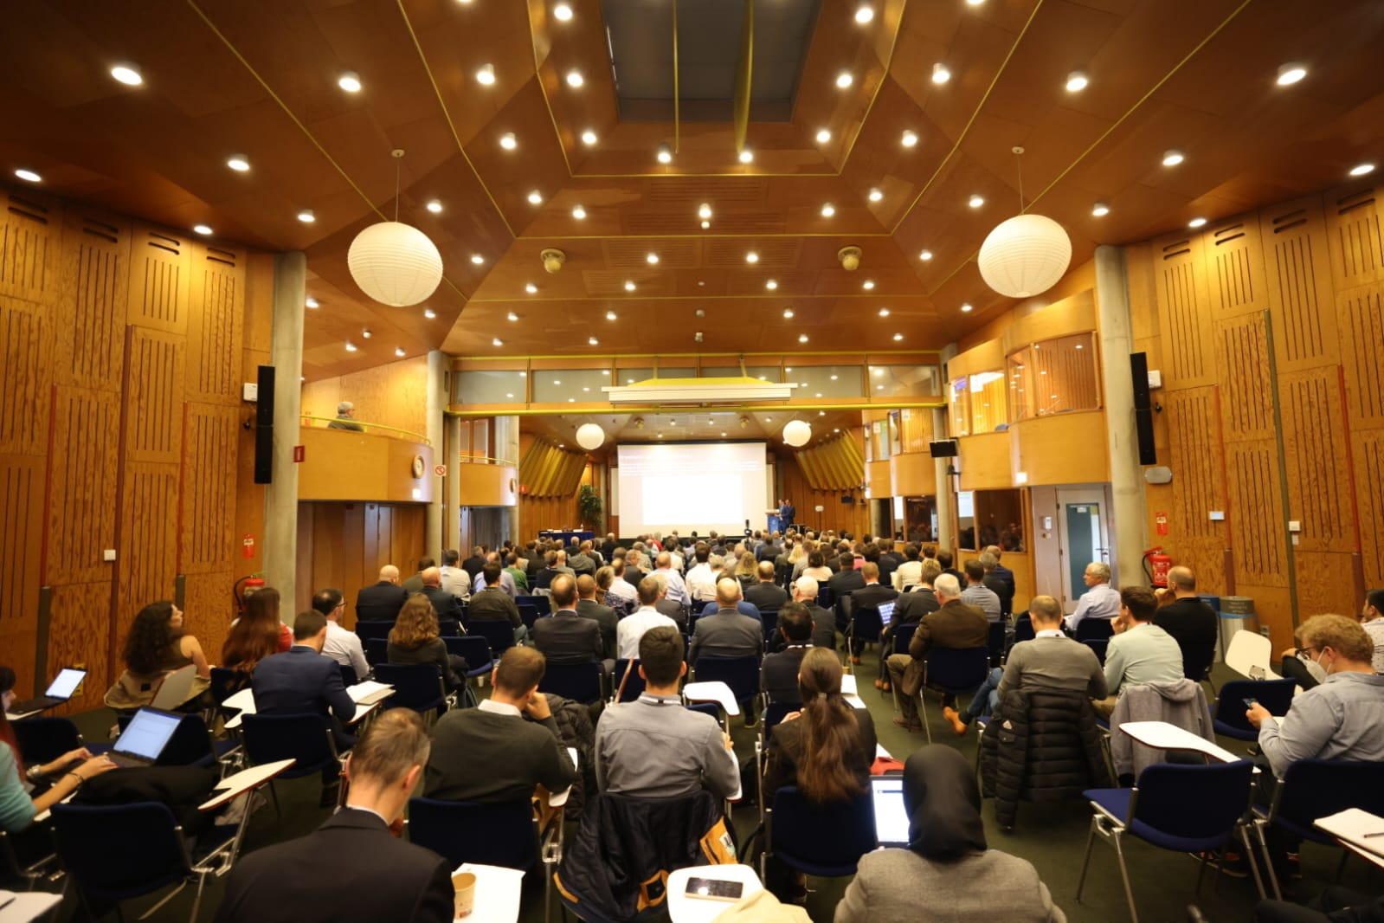
239 participants!

Slide 3
SPCD 2022
Jointly organized by
Co-sponsored by

Slide 4
Aim of the SPCD Conference
The SPCD international Symposium is the premier technical conference dedicated to Passive components for space applications.

Slide 5
Aim of the SPCD Conference
Space Agencies
Manufacturers
End-users
promote the discussion of recent developments and trends
encourage the exchange of technical expertise
share information covering a broad range of EEE passive components for space applications

Slide 6
SPCD Events
The SPCD international Symposium is held every two years!
SPCD | Date | Participants |  | Countries | Type
1st edition | 24 -26 September 2013 | 212 |  | 21 | Live
2nd edition | 12- 14 October 2016 | 221 |  | 19 | Live
3rd edition | 9 – 12 October 2018 | 235 |  | 23 | Live
 | 13 -16 October 2020 | Event postponed due to the pandemic situation
4th edition | 11- 14 October 2022 | 239 | 21 |  | Live

Slide 7
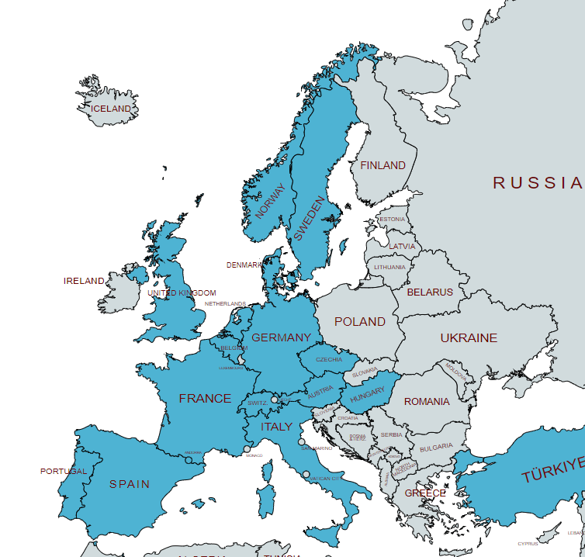
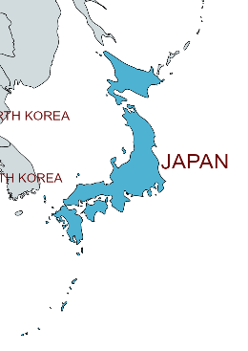
SPCD Statistics: International Participation

Slide 8
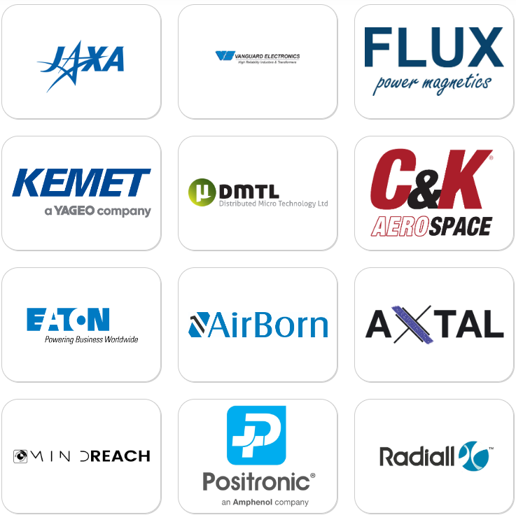
29 Exhibitors at SPCD 2022

Slide 9
Feedback from 4th SPCD attendees

Slide 10
“Another great event! Congratulations to Léo, Joaquin, and the whole team for all the effort - and for always making the gala dinner night (and other events) unforgettable!” N.K Axon
“Great event !!! It was nice to see known and new faces after four years. Thanks a lot for excellent organization” EPCI
“Thank to all organaizers team and all presenters. It was exciting session“ S. L. Vzlu
“Always an outstanding event (networking, good talks, music and fun).” BZ Schurter
“great event - thank you!” Airborn
“Thank you for this great event.” C&K
“Thank you for having organizing this event. Congratulations, it was nicely done.” JL. C. TAS
“Great seminar with interesting presentation and good specialized audience.” N.D. Exxelia
“I was satisfied because there were many interesting topics. I will attend next time.” JAXA
“We really feel a positive and constructive atmosphere during the event.” M.D Exxelia
“A big five to the organisation. We have been received like princes :)“
M.B. TAS

Slide 11
4th SPCD Programme
Pre-conference Event:
11 October 2022
ESCC training course
EEE Passive Seminar by EPCI/ALTER/SERMA
ESA Site Tour: Test Centre & Electrical Lab + Space Expo Museum
SPCD Conference :
12-14 October 2022
Oral presentations
Dedicated Poster session
Technical Introduction of Components (TICs)
Interactive Panel session
Private Roadmap session
Industrial Exhibition (max 30 booths)

Slide 12
Social Events
Welcome Drink
Wednesday 12 October 2022 @18h00
Refreshments and Snacks will be served.
Gala Dinner
Thursday 13 October 2022 @19h30
The aperitif will start as of 19:30, followed by a seated dinner

Slide 13
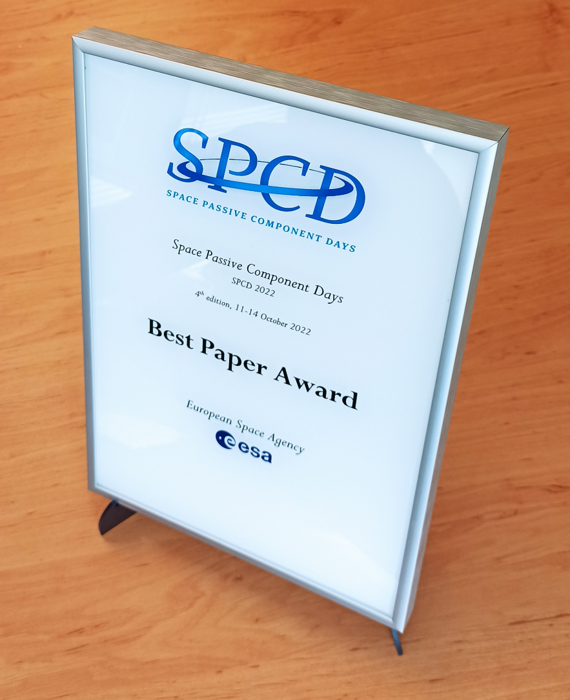
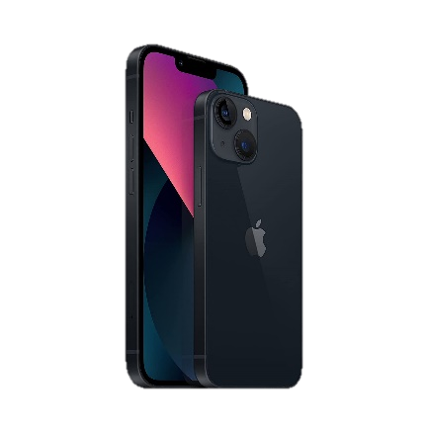
Best Paper Award
Radiall
EU Selector: SMT RF switch
Apple iPhone 13
256GB Space Gray

Slide 14
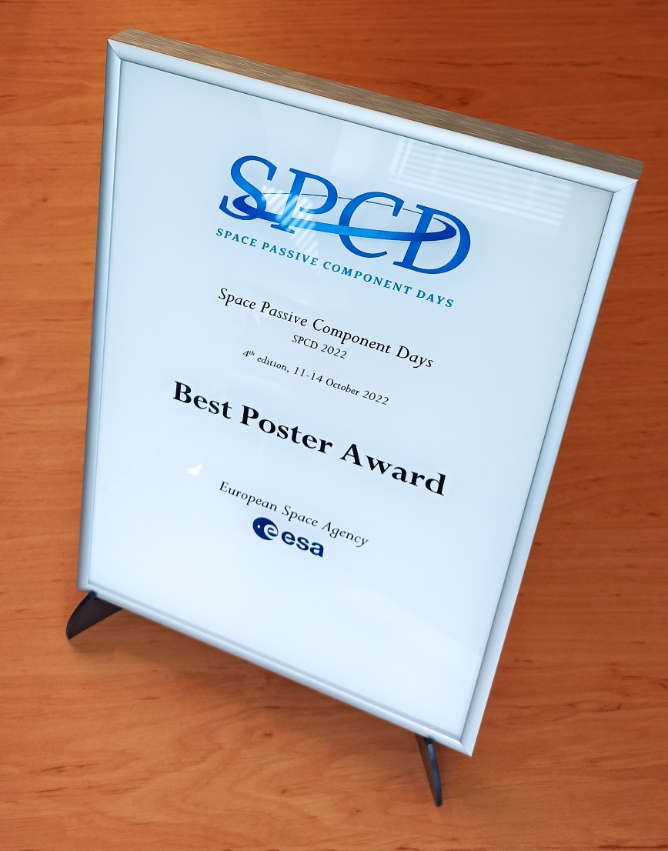
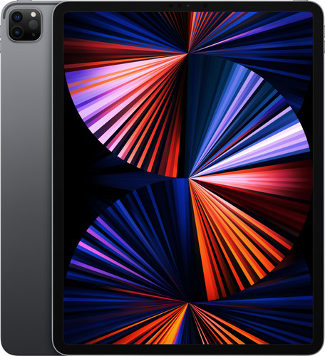
Best Poster Award
COBHAM
SMD Ka band Isolator
Apple iPad Air 2022
256 GB Wifi + 5G

Slide 15
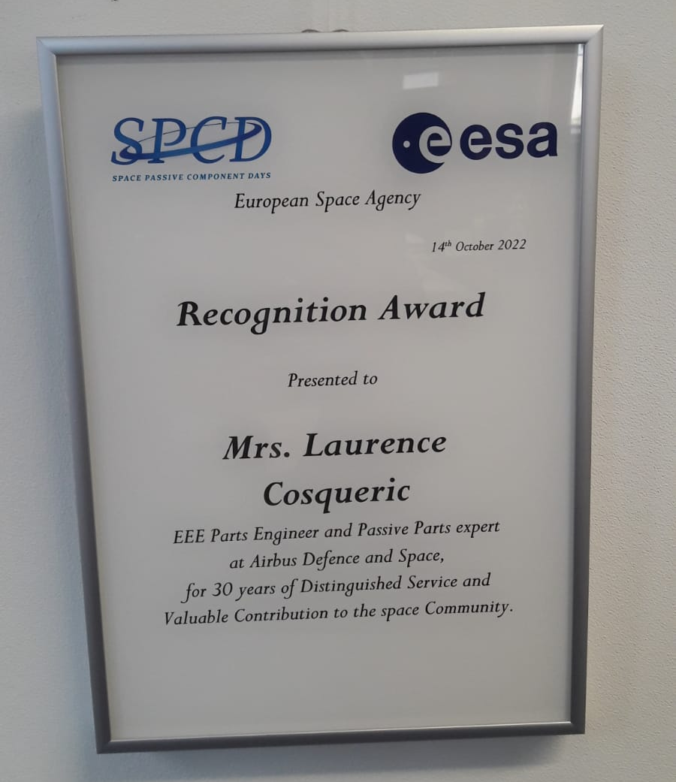
Recognition Award

Slide 16
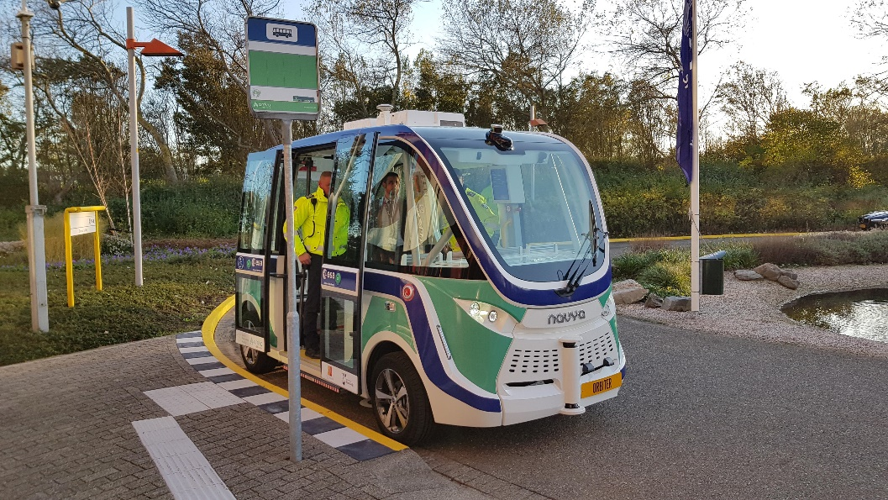
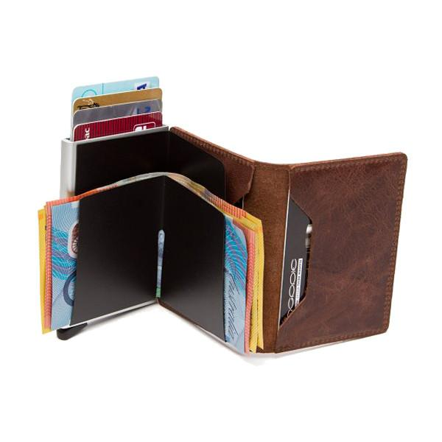
SPCD Space Fun Challenge: Enigma to solve!
I can orbit
But not around the sun
I don’t fly
But for a ride, I can be fun
You don’t have to pay
As I cost none
Around Estec, I am the only one!
Answer is:
ORBITER
Secrid Wallet
Made in Holland!

Slide 17
How Can You Participate in SPCD?
As a Presenter:
Present a technical paper or a poster by submitting an abstract and choosing your presentation preference.
As a Commercial Presenter:
Give a commercial presentation by submitting a Technical Introduction of Components (TICs).
As a Roadmap Presenter:
Present your company's roadmap to purchasing and supply managers only.
As an Exhibitor:
Exhibit by booking a booth and promoting your services and components.
As a Sponsor:
Provide your company with greater visibility by choosing one of the sponsorship packages.
As a Participant:
Register to the conference and take advantage from the conference presentations, exhibition, networking breaks, welcome drink and the Gala dinner.
Abstract Submission
TIC Submission
Roadmap Presentation Submission
Apply to Exhibit
Apply to Sponsor
Register

